Slide 1

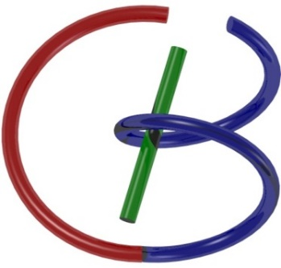
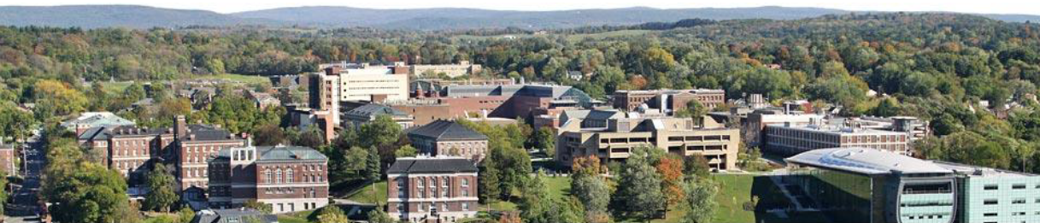
More CT Stuff
Ge Wang
AI-based X-ray Imaging System (AXIS) Lab
Rensselaer Polytechnic Institute, Troy, New York, USA
Oct. 8, 2021

Slide 2
MI Schedule for F21
Tue | Topic | Fri | Topic
08/31 | Introduction | 09/03 | Neuron, Network & Backpropagation
09/07 | No Class | 09/10 | Hands-on 1: Python, Colab, & TensorF
09/14 | Architectures & Training | 09/19 | Hands-on 2: MNIST Classification
09/21 | Image Quality I | 09/24 | CT Physics
09/28 | CT Reconstruction | 10/01 | Deep CT Reconstruction
10/05 | Hands-on 3: CT Networks | 10/08 | More CT Contents
10/12 | MRI Physics | 10/15 | Spin-Echo
10/19 | K-Space Theorem | 10/22 | More MRI Contents
10/26 | Mid Exam | 10/29 | Deep MRI Reconstruction
11/02 | Hands-on 4: MRI Networks | 11/05 | Nuclear Physics
11/09 | Nuclear Imaging | 11/12 | US Imaging
11/16 | Optical Imaging | 11/19 | Multimodality Imaging
11/23 | Hands-on 5: Image Conversion | 11/26 | Thanksgiving
11/30 | Image Quality II | 12/03 | Stability, Interpretability, & Others
12/07 | Overview | 12/10 | Final Exam
Office Hour: Teaching Day 5-6pm: https://rensselaer.webex.com/meet/wangg6

Slide 3
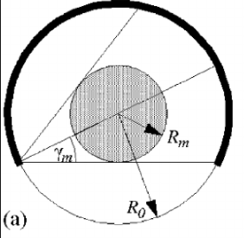
Half-scan Angular Range

Slide 4
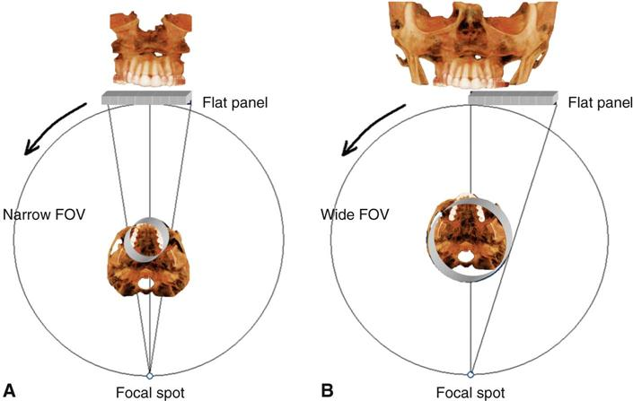
Is Full-scan (360˚) Necessary?

Slide 5
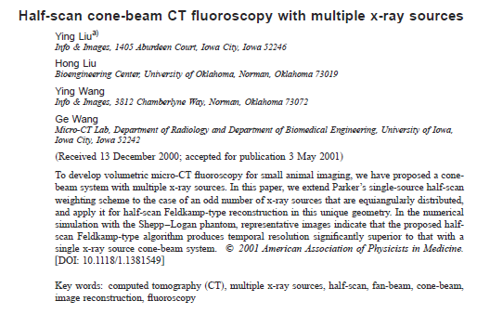
What Is the Min Angular Range?

Slide 6
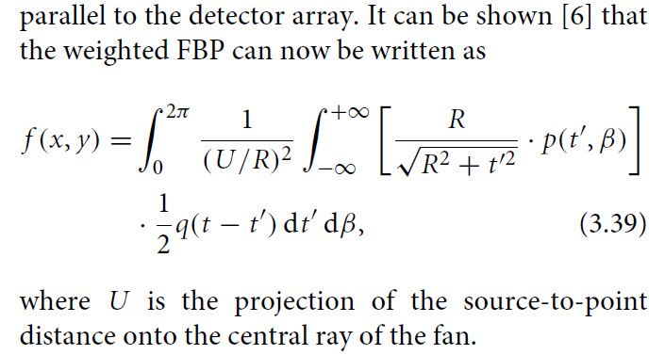
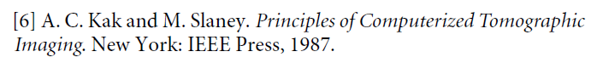
Equi-spatial Fan-beam Formula
Wang, Lin, Cheng: IEEE TIP 2:543-547, 1993

Slide 7
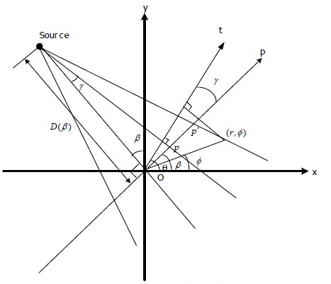
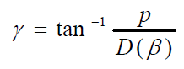
Where Error Is?

Slide 8
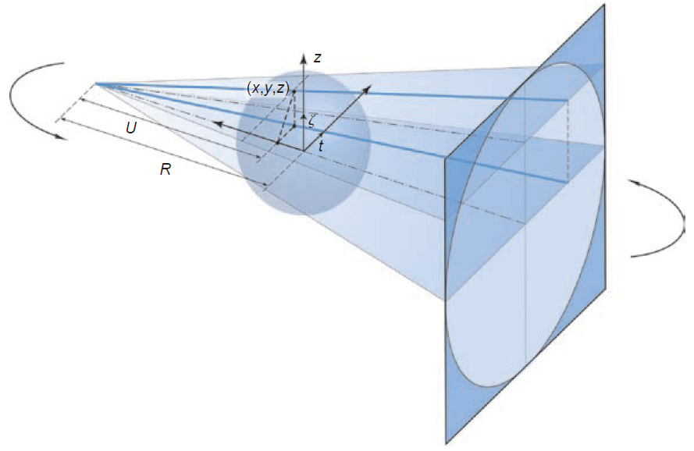
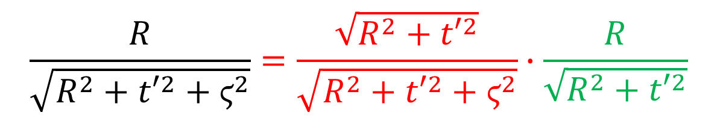
Cone-beam Scanning
α
β
General Scanning Trajectory
$$\frac{R}{\sqrt{R^{2}+{t′}^{2}+ϛ^{2}}}=\frac{\sqrt{R^{2}+{t′}^{2}}}{\sqrt{R^{2}+{t′}^{2}+ϛ^{2}}}∙\frac{R}{\sqrt{R^{2}+{t′}^{2}}}$$

Slide 9
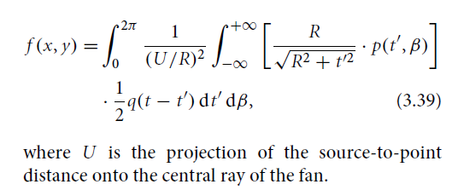
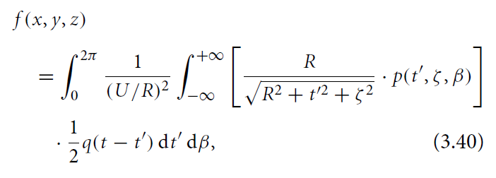
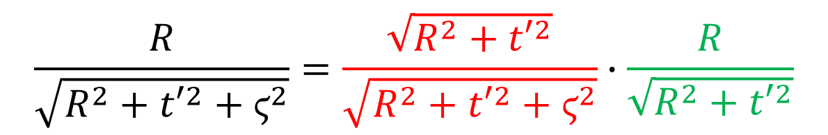
Obliqueness Correction
Obliqueness Correction in Fan-beam Formula
An X-ray Hits the 2D Detector Plate Obliquely, Determined by Two Angles
Obliqueness Correction in Cone-beam Formula
$$\frac{R}{\sqrt{R^{2}+{t′}^{2}+ϛ^{2}}}=\frac{\sqrt{R^{2}+{t′}^{2}}}{\sqrt{R^{2}+{t′}^{2}+ϛ^{2}}}∙\frac{R}{\sqrt{R^{2}+{t′}^{2}}}$$

Slide 10
Outline
Spiral CT – Longitudinal Data Truncation
General Idea
Approximate & Exact Image Reconstruction
Interior Tomography – Transverse Data Truncation
General Idea
Main Merits

Slide 11
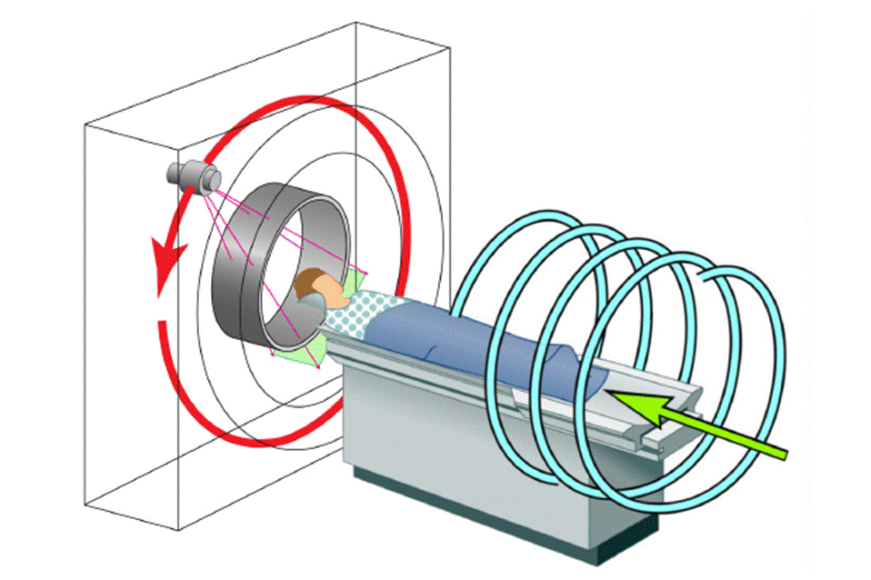
Spiral Cone-beam CT
Wang, G, Lin, TH, Cheng PC, Shinozaki DM, Kim HG: Scanning cone-beam reconstruction algorithms for x-ray microtomography. Proc. SPIE 1556:99-112, July 1991
Wang G, Lin TH, Cheng PC, Shinozaki DM: A general cone-beam reconstruction algorithm. IEEE Trans. on Med. Imaging 12:486-496, 1993

Slide 12
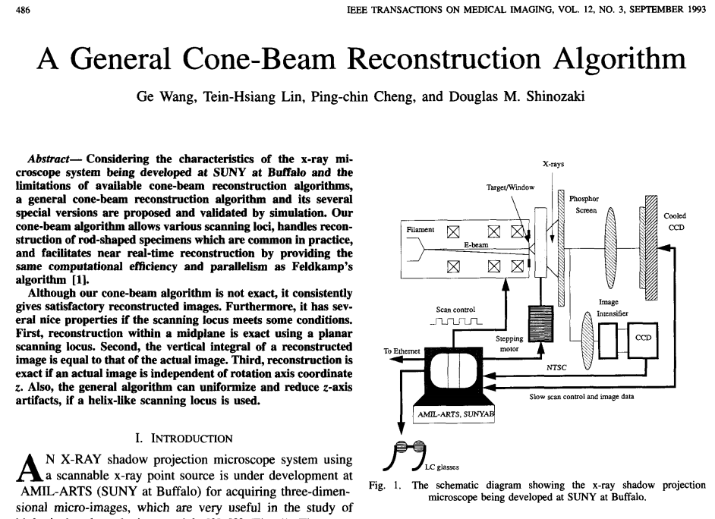

Slide 13
Impact of Spiral Cone-beam Scanning
There are ~200M Multi-slice/Cone-beam CT Scans Annually, a Majority of Which are in the Spiral/Helical Cone-beam/Multi-slice Mode
To solve the long-object problem, a first level of improvement with respect to the 2D FBP algorithms was obtained by backprojecting the data in 3D, along the actual measurement rays. The prototype of this approach is the algorithm of Wang et al.
Defrise, Noo, Kudo: A solution to the long-object problem in helical cone-beam tomography. Phys. Med. Biol. 45:623-643, 2000
Many advances in cone-beam reconstruction have been made recently thanks to the quest for an attractive reconstruction method in helical cone-beam tomography.
Pack, Noo, Clackdoyle: Cone-beam reconstruction using the backprojection of locally filtered projections. IEEE Trans. Medical Imaging 24:1-16, 2005

Slide 14
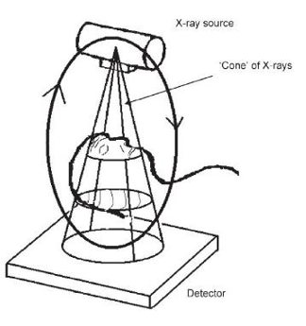
Data Sufficiency in 3D
At least a point on a source orbit on any plane in an object

Slide 15
Tam Window & PI-Line (Necessity)
A PI-Segment is a line segment with its endpoints on one helical turn. Every point is on one and only one PI-line (you can try to prove!).
The helical portion between the two endpoints of a PI-Segment is called a PI-arc.
Tam window is defined as the detector area on a cylindrical surface delimited by two consecutive helical turns (also called the Tam-Danielsson Window).
Tam-Window
PI-Segment

Slide 16
Perfect Mosaic (Global Involvement)
Seamless Coverage with Divergent X-rays
To compute planar integrals, Grangeat’s algorithm requires that the cone-beam data is not truncated
To employ Grangeat’s algorithm for spiral cone-beam CT, a perfect mosaic scheme is designed to compute planar integrals
Oblique Plane Cutting through a Long Object

Slide 17
Exact Spiral Cone-beam CT
Object
Source
Pi-Line
Detector
Plate
Katsevich A: An improved exact filtered backprojection algorithm for spiral computed tomography. Advances in Applied Math. 32: 681-697, 2004

Slide 18
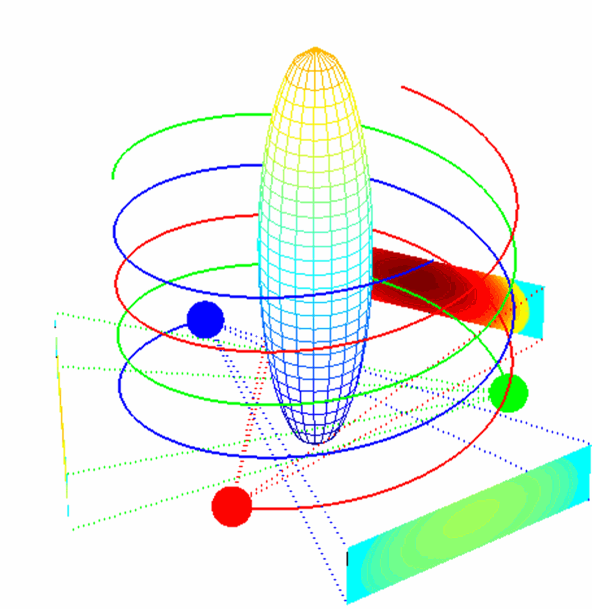
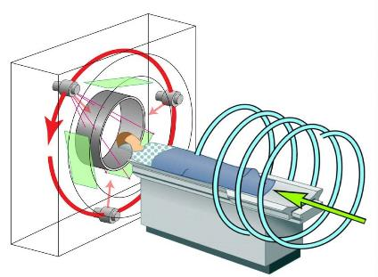
Triple-source Spiral Cone-beam CT
Zhao, J, Jin YN, Lv Y, Wang G: A filtered backprojection algorithm for triple-source helical cone-beam CT. IEEE Trans. Med. Imaging 28:384-393, 2008
Lv Y, Katsevich A, Zhao J, Yu HY, Wang G: Fast exact/quasi-exact FBP algorithms for triple-source helical cone-beam CT. IEEE Trans. Med. Imaging 29:756-770, 2010

Slide 19
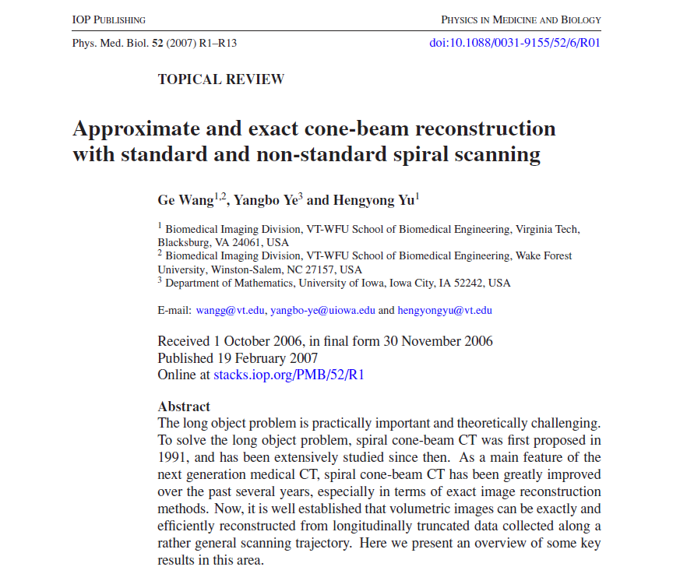

Slide 20
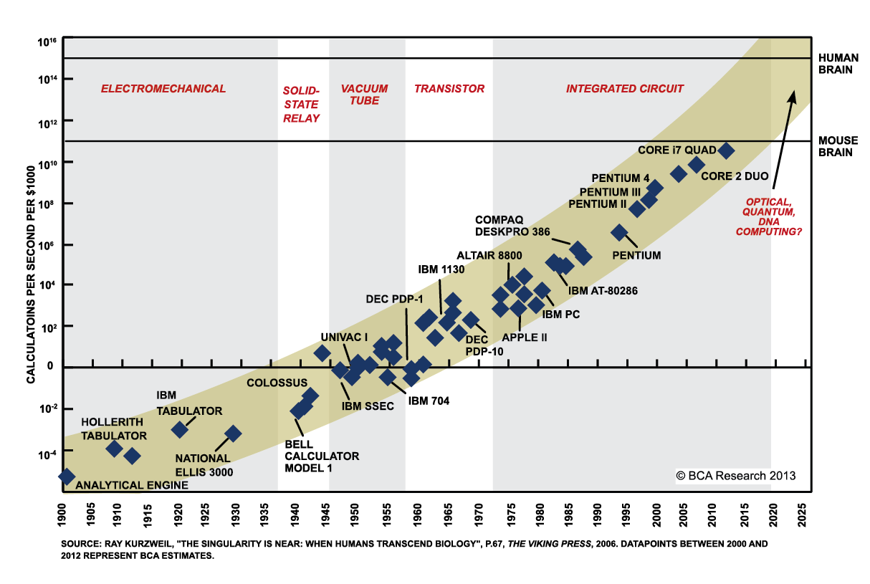

Slide 21
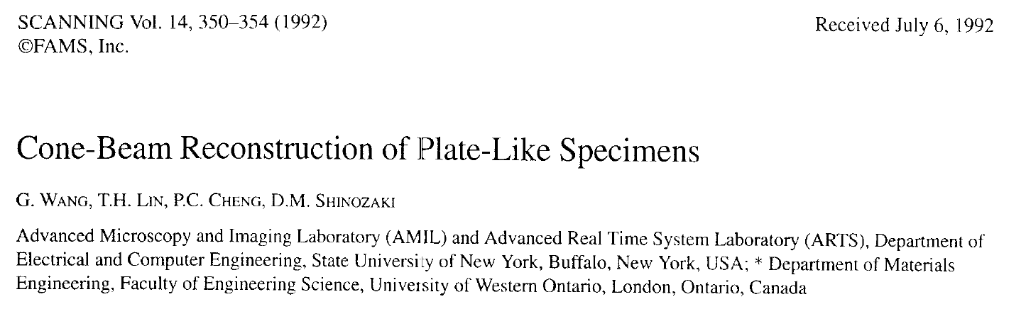
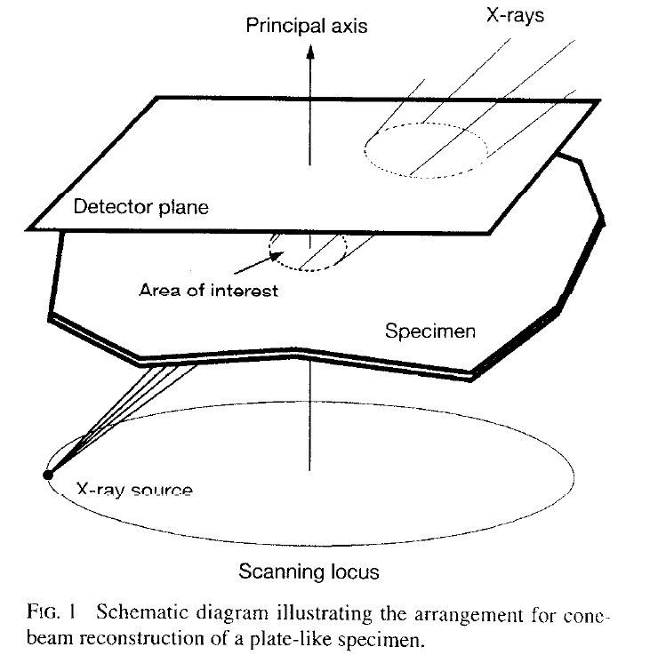
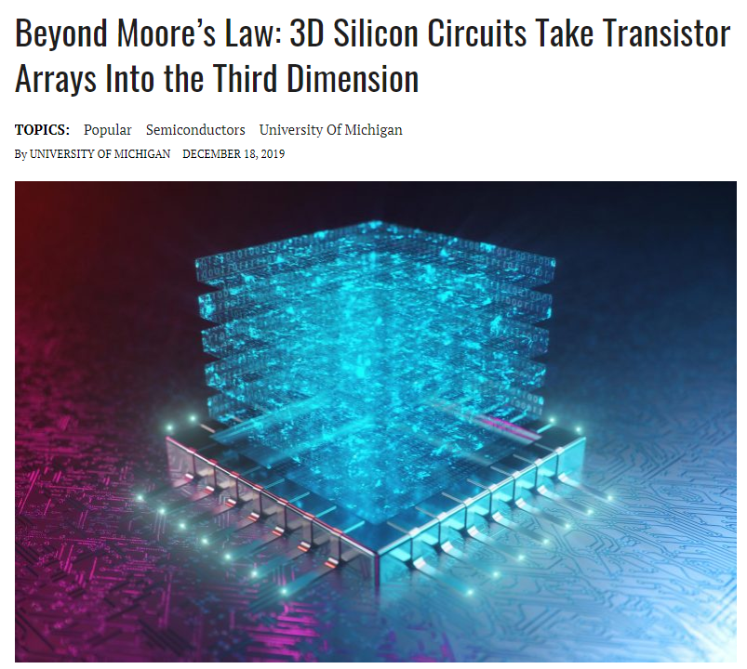

Slide 22
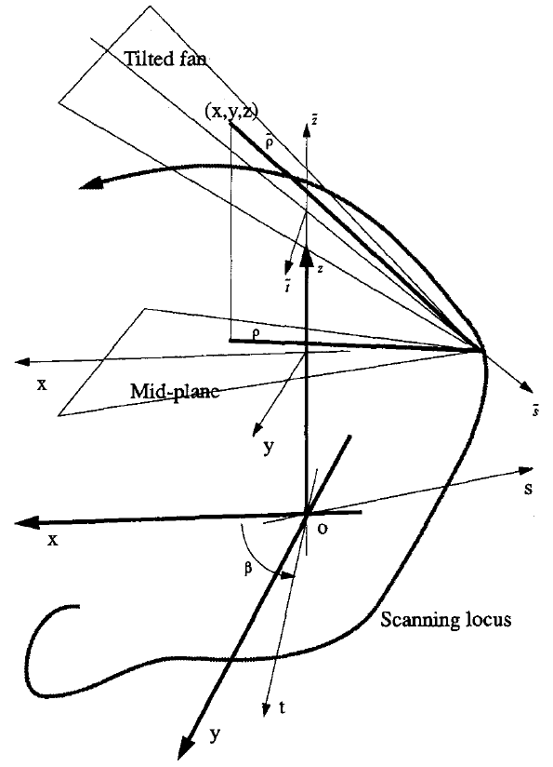
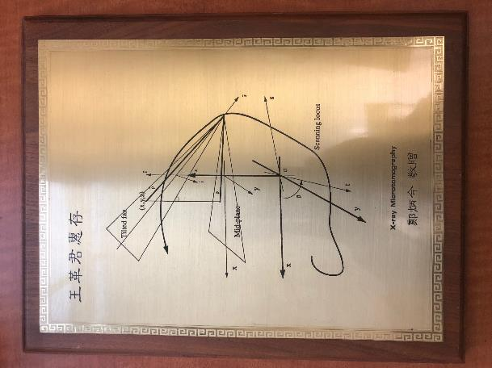
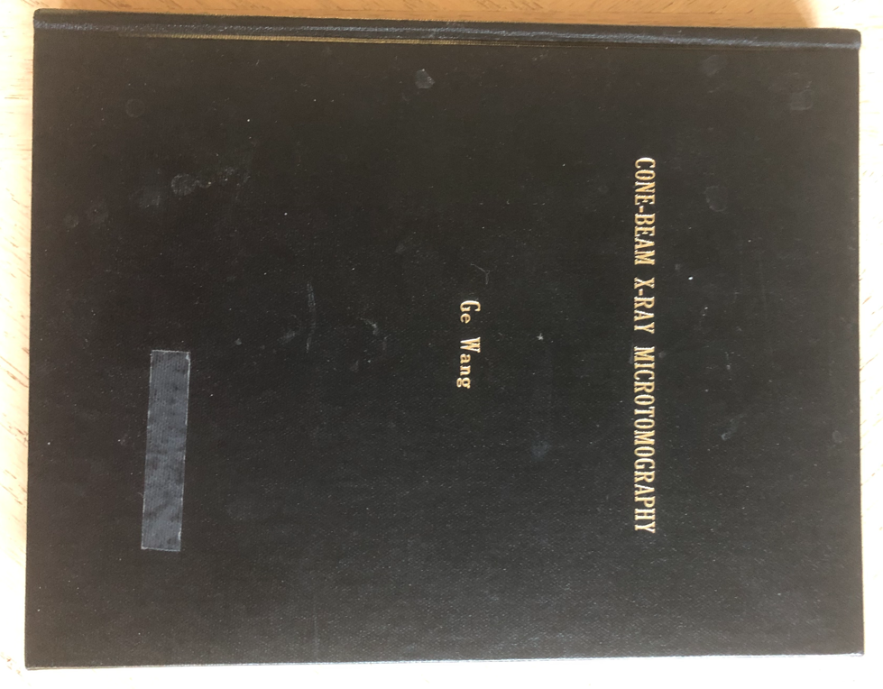
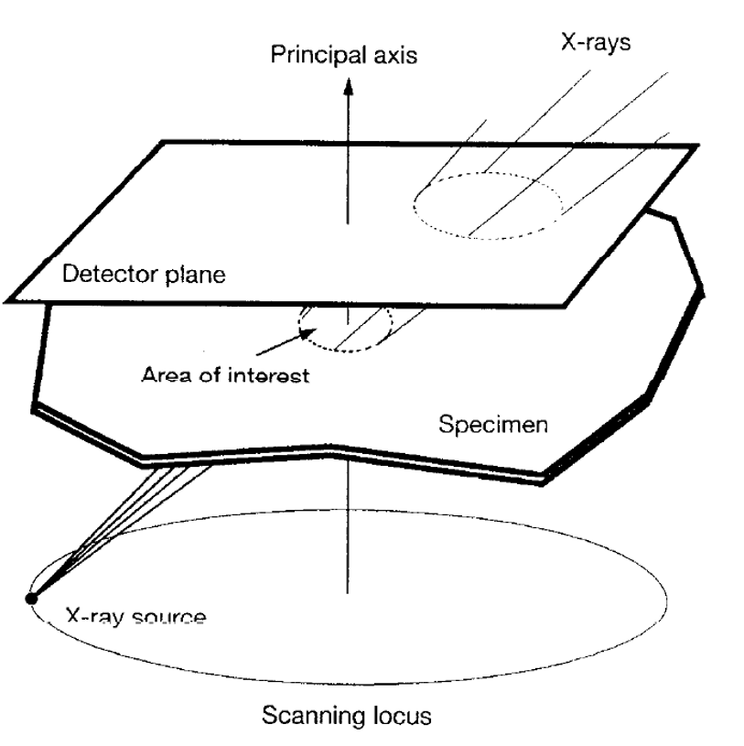
Ge’s PhD Dissertation 30 Years Ago

Slide 23
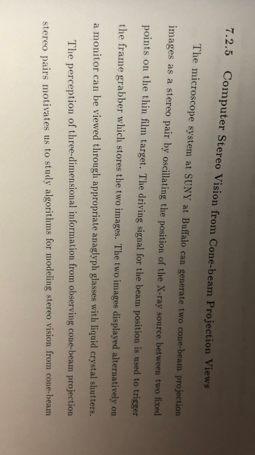

Slide 24
Outline
Spiral CT – Longitudinal Data Truncation
General Idea
Approximate & Exact Image Reconstruction
Interior Tomography – Transverse Data Truncation
General Idea
Main Merits

Slide 25
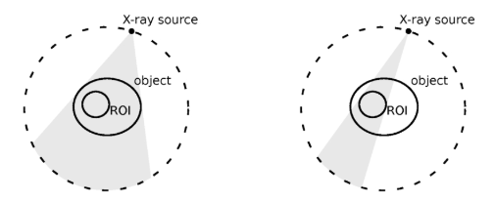
Interior Problem
Interior Problem Is to Perform Image Reconstruction over an Interior Region of Interest (ROI) from Transversely Truncated Data in an Exact Fashion.
Ueda et al.: https://doi.org/10.1117/12.2255706

Slide 26

Solution Non-uniqueness
According to page 169 of Natterer’s book, there are many non-trivial ghost functions in the interior ROI.
A ghost function does not affect the measured interior scan data at all.
The variation of the ghost is small well inside the ROI but it increases rapidly towards the boundary of the ROI, and not bounded.
Hence, theoretically exact image reconstruction over the ROI is simply impossible in an unconstrained functional space.

Slide 27
Two Conclusions (Heuristic but Misleading!)
From the “particle” (pixel/voxel) point of view, we have to peel an onion from outermost to inner most. In this process, each measurement carries unique information (line integral and planar integrals in the 2D and 3D cases respectively). Only when outer shells are determined, we can estimate pixel/voxel values of inner shells. Hence, “outer” data are needed for interior reconstruction.
From the “wave” (Fourier analysis) point of view, all the measurement data are collected to fill in the Fourier space and are necessary since you do need all the Fourier spectral components to perform the inverse Fourier transform that is to reconstruct an underlying image. Any data truncation will compromise some Fourier components adversely, and globally affect the quality of a reconstructed image.

Slide 28
Interior Tomography
_{Known}
_{Sub-region}
_{Sparsity}
_{Model}
_{Wide Beam}
_{Narrow Beam}
_{Source}
_{ROI}
_{ROI}
_{ROI}
_{Object}
_{Trajectory}
_{Trajectory}
_{Regular Reconstruction}
_{Interior Problem}
_{Landmark-based}
_{Interior Tomography}
_{Sparsity-based}
_{Interior Tomography}

Slide 29
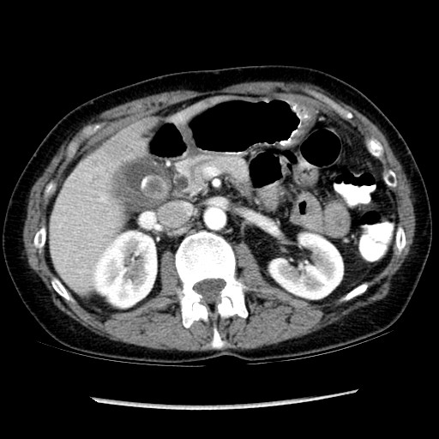
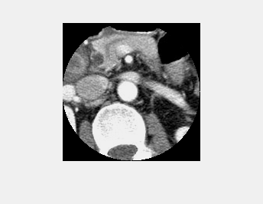
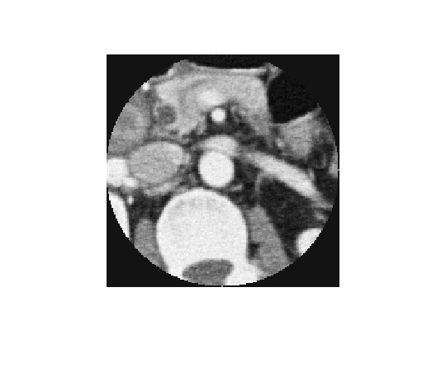
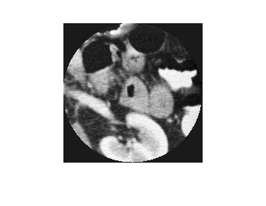
Interior Reconstruction
Global Reconstruction from Complete Projections
Ground Truth ROIs
from Global Reconstruction
Interior Reconstruction from Truncated Projection

Slide 30
Merits of Interior Tomography
Less Is Deeper
Less Is Larger
Less Is Faster
Less Is Less
Less Is More

Slide 31
Less Is Deeper
Use of less projection data for accurate image reconstruction demands deeper insight, more advanced theory and more powerful tools.

Slide 32


Computed Tomography (Wholesale)
Measurement
Projection: Linear integrals
y
t
Sinogram
θ
π
θ
x
Object
X-rays
t
Reconstruction

Slide 33
Inner Vision with Local Data (Retail)
Measurement
Projection: Linear integrals
y
t
Sinogram
θ
π
θ
x
X
X
Object
X-rays
t
Reconstruction

Slide 34
Less Is Larger
Acquisition of less projection data is achieved with a narrower beam, and an object larger than the beam width is not a concern.

Slide 35

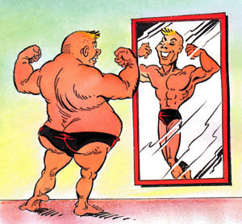
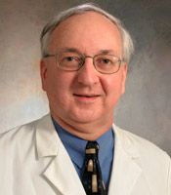
Big Patient Problem

Slide 36
Less Is Faster
Less data means smaller detector size, faster frame rate, and more imaging chains, all of which contribute to an accelerated data acquisition process.

Slide 37
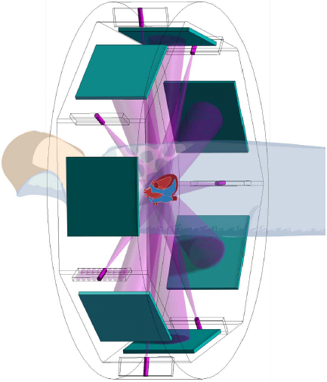
Multi-source Interior Tomography
Ye YB, Yu HY, Wei YC, Wang G. International Journal of Biomedical Imaging, Article ID:63634, 2007
Wang G, Yu H, Ye Y. Medical Physics. 36:3575-3581, 2009
Wang G, Yu H, Ye YB. Virginia Tech Patent Disclosure on May 15, 2007, US Patent Application 12/362,979 allowed on October 21, 2009
Source
Detector

Slide 38
Less Is Less
Less data is equivalent to less radiation dose, because of not only a narrower beam but also a more relaxed angular sampling requirement in the longitudinal studies or multi-scale scenarios.

Slide 39
Less Is More
Use of less data is advantageous in more modalities beyond CT, such as other straight-ray tomographic techniques and even in small-angle curvilinear geometry, and more applications of various types. Furthermore, less data means more recon/training time!

Slide 40


Slide 41


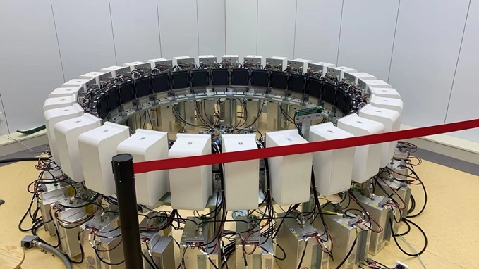
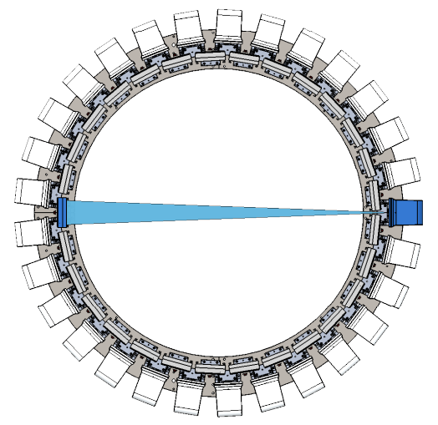

SMART Imager
Stationary Multi-source AI-powered Real-time Tomography (SMART)
Detector
y
Source
o
x
Source
Detector
#Wu WW, #Tang YH, Lv TL, Niu C, Wang C, Guo YY, Chang YC, *Wang G, *Xi Y: Stationary Multi-source AI-powered Real-time Tomography (SMART) for Dynamic Cardiac Imaging. ArXiv, 2021

Slide 42
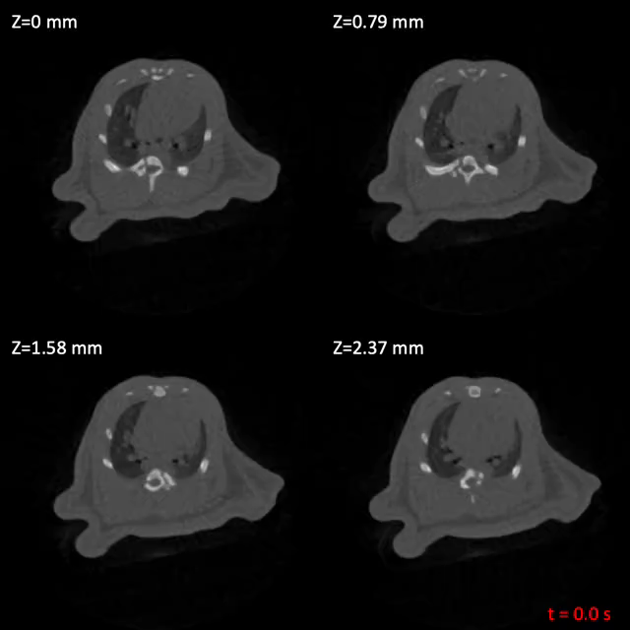
Sparsity Promotion + Deep Image Prior
Noisy Input
U-Net Module
Output
Image
#Wu WW, #Tang YH, Lv TL, Niu C, Wang C, Guo YY, Chang YC, *Wang G, *Xi Y: Stationary Multi-source AI-powered Real-time Tomography (SMART) for Dynamic Cardiac Imaging. ArXiv, 2021

Slide 43
Deep Image Prior
Dmitry Ulyanov, Andrea Vedaldi, Victor Lempitsky
Partial content of this slide refers the presentation given by Dmitry Ulyanov regarding to the paper

Slide 44
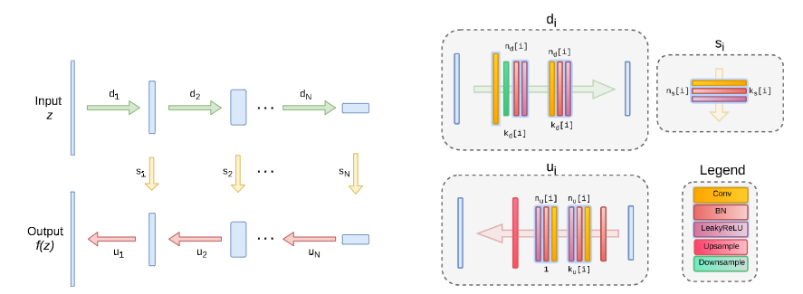
Architecture used in the experiments

Slide 45
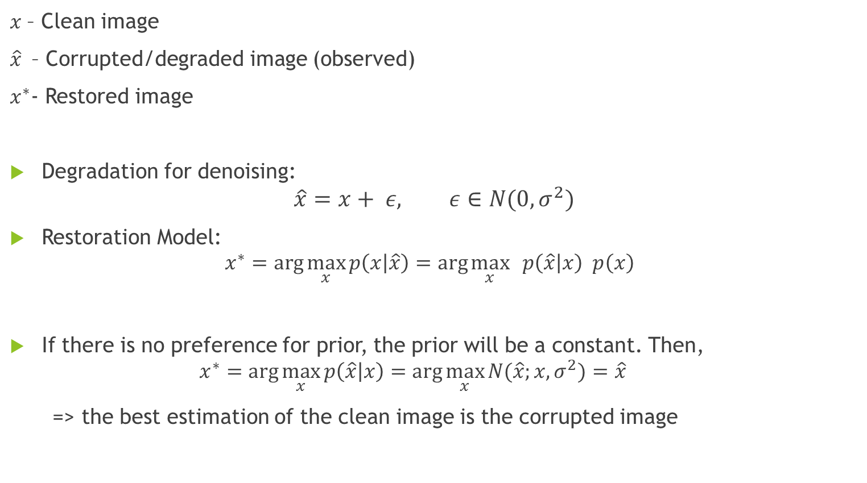
Image restoration - Method
$x$– Clean image
$\hat{x}$ – Corrupted/degraded image (observed)
$x^{∗}$- Restored image
Degradation for denoising:
$$\hat{x}=x+ ε, ε∈N(0, σ^{2})$$
Restoration Model:
$$x^{∗}=\arg{\max_{x}{p\left(x | \hat{x}\right)=\arg{\max_{x}{ p\left(\hat{x} | x\right) p\left(x\right) }}}}$$
If there is no preference for prior, the prior will be a constant. Then,
$$x^{∗}=\arg{\max_{x}{p\left(\hat{x} | x\right)=\arg{\max_{x}{N(\hat{x};x,σ^{2})}}}}=\hat{x}$$
=> the best estimation of the clean image is the corrupted image
likelihood prior

Slide 46
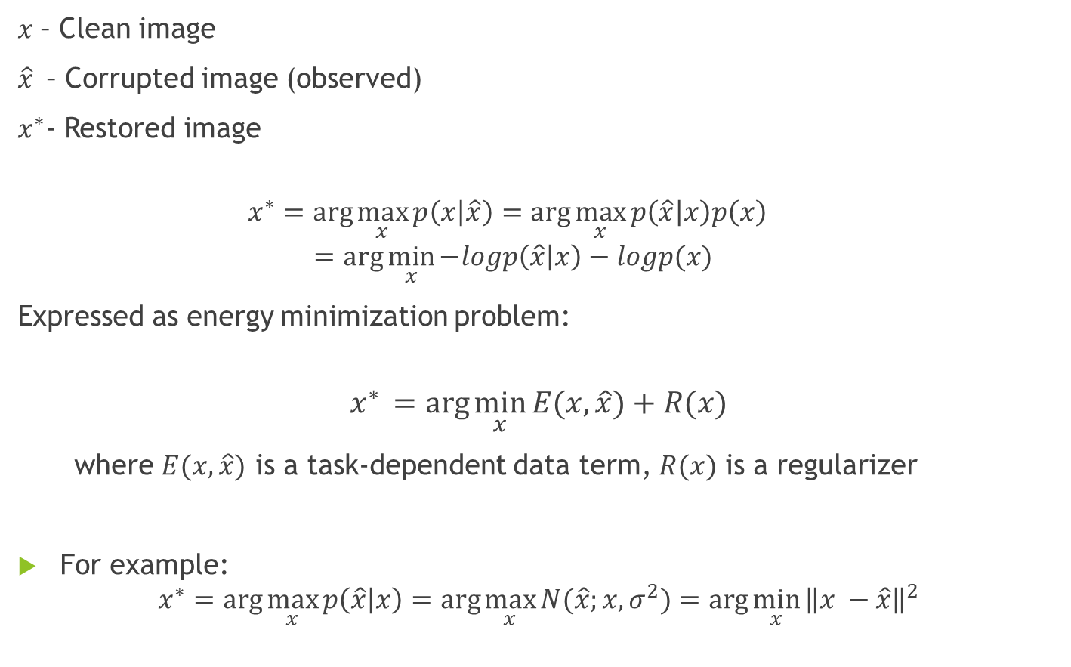
$x$– Clean image
$\hat{x}$ – Corrupted image (observed)
$x^{∗}$- Restored image
$$x^{∗}=\arg{\max_{x}{p\left(x | \hat{x}\right)=\arg{\max_{x}{p\left(\hat{x} | x\right)p\left(x\right) }}}}$$
$$=\arg{\min_{x}{−logp\left(\hat{x} | x\right)−logp(x)}}$$
Expressed as energy minimization problem:
$$x^{∗} =arg{\min_{x}{E(x,\hat{x})+R(x)}}$$
where $E(x,\hat{x})$ is a task-dependent data term, $R(x)$ is a regularizer
For example:
$$x^{∗}=\arg{\max_{x}{p\left(\hat{x} | x\right)=\arg{\max_{x}{N(\hat{x};x,σ^{2})}}}=\arg{\min_{x}}{\left\|x −\hat{x}\right\|}^{2}}$$

Slide 47
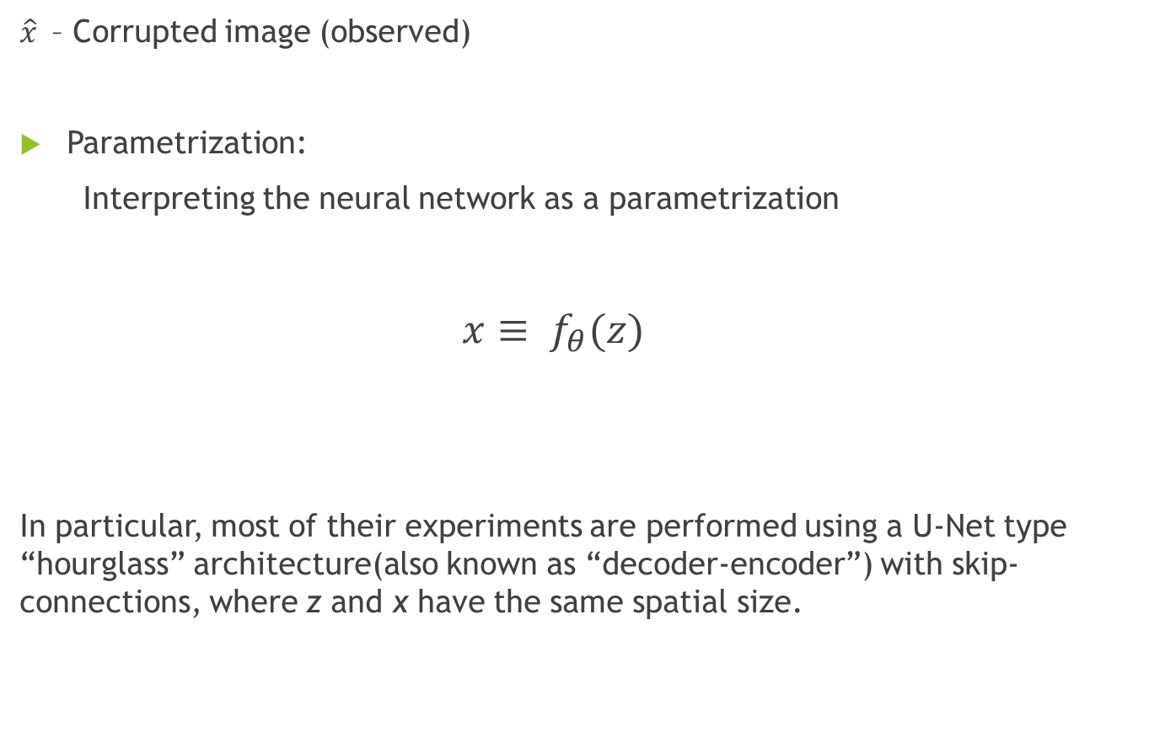
Deep Image Prior
$\hat{x}$ – Corrupted image (observed)
Parametrization:
Interpreting the neural network as a parametrization
$x≡ f_{θ}(z)$
In particular, most of their experiments are performed using a U-Net type “hourglass” architecture(also known as “decoder-encoder”) with skip-connections, where z and x have the same spatial size.
Fixed input z
Convolutional network with parameter θ

Slide 48
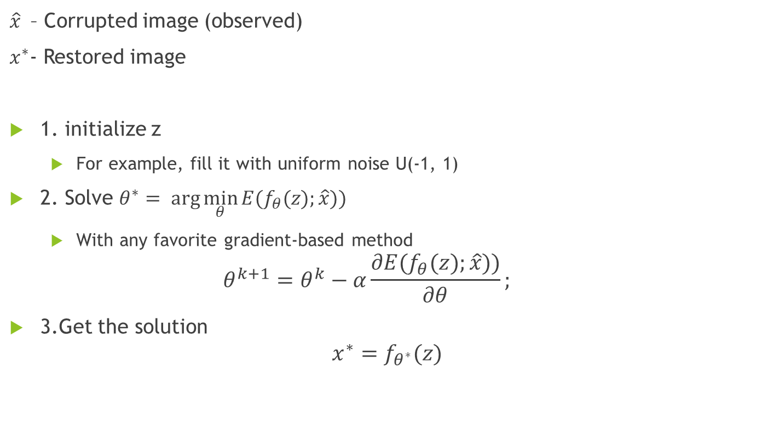
Deep Image Prior step by step
$\hat{x}$ – Corrupted image (observed)
$x^{∗}$- Restored image
1. initialize z
For example, fill it with uniform noise U(-1, 1)
2. Solve $θ^{∗}= arg{\min_{θ}{E(f_{θ}(z);\hat{x}))}}$
With any favorite gradient-based method
$$θ^{k+1}=θ^{k}−α\frac{∂E(f_{θ}(z);\hat{x}))}{∂θ};$$
3.Get the solution
$$x^{∗}=f_{θ^{∗}}(z)$$

Slide 49
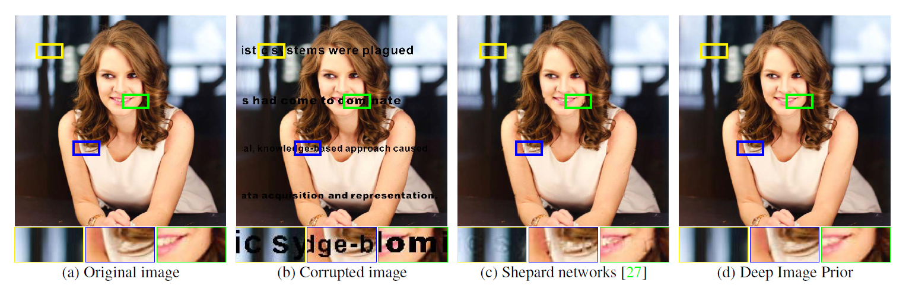
Inpainting Text inpainting

Slide 50
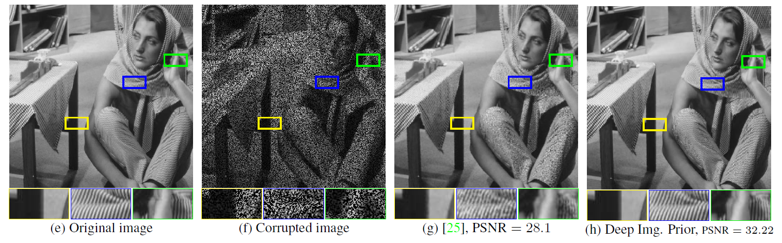
Image restoration
sampled to drop 50% of pixels at random
g is the result from comparison with Shepard networks

Slide 51
Homework
Finishing reading Chapter 3 of the textbook by Paul
Understand the derivation steps (Eqs. (1) – (10)) in the 1st cone-beam spiral/helical CT paper (approximate spiral cone-beam reconstruction): https://ieeexplore.ieee.org/stamp/stamp.jsp?tp=&arnumber=241876, and explain the derivation in your own words in a tutorial-like report (see the following slides as hints)

Slide 52
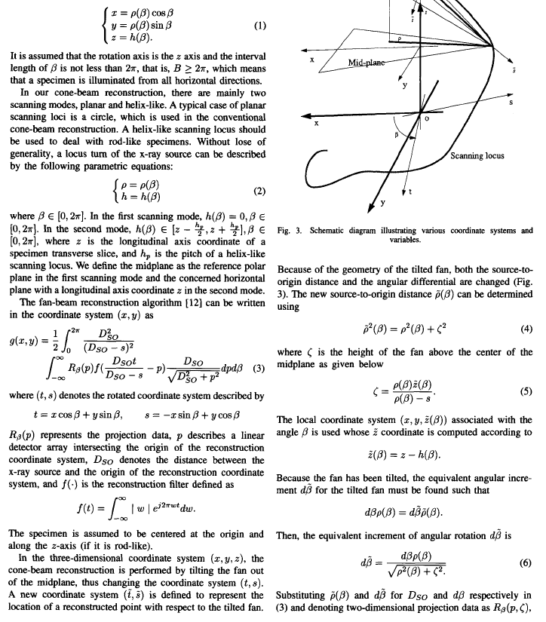
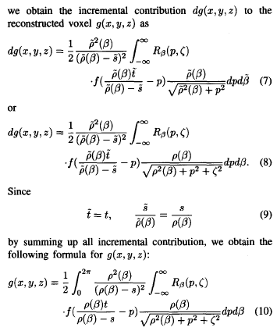

Slide 53
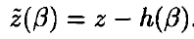




Geometric Relationship
Arbitrary Point (Impulse)
X-ray source on the s-axis

Slide 54



Differential Contribution

